Slide 1
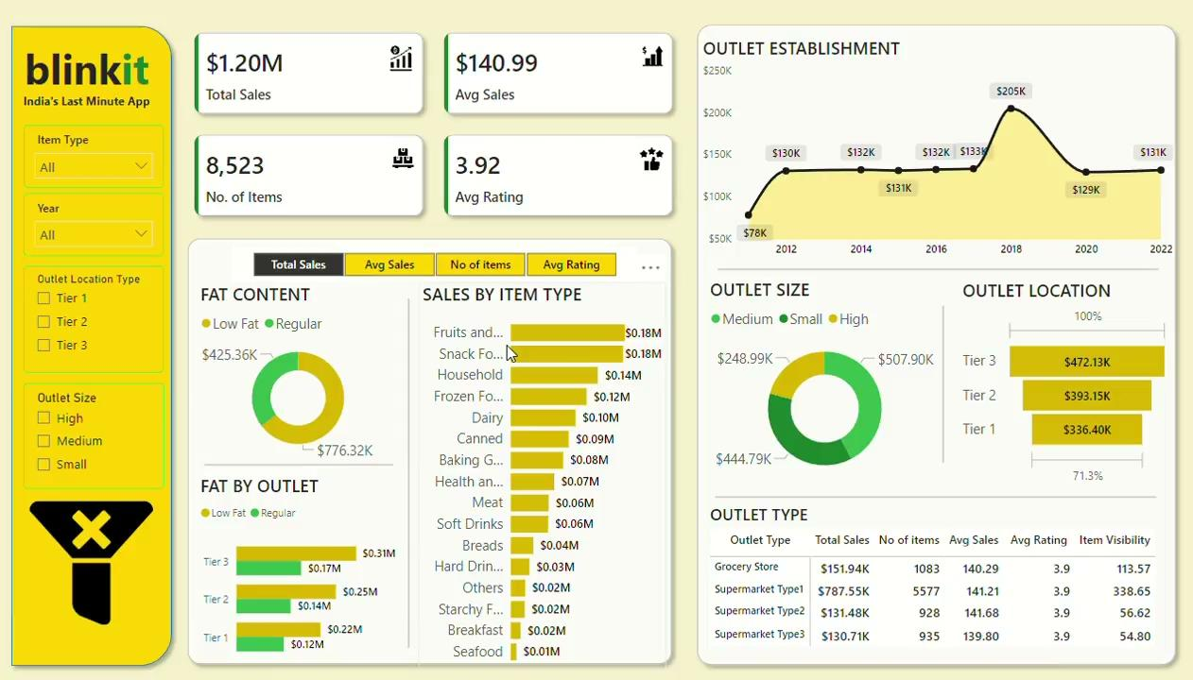

Slide 2
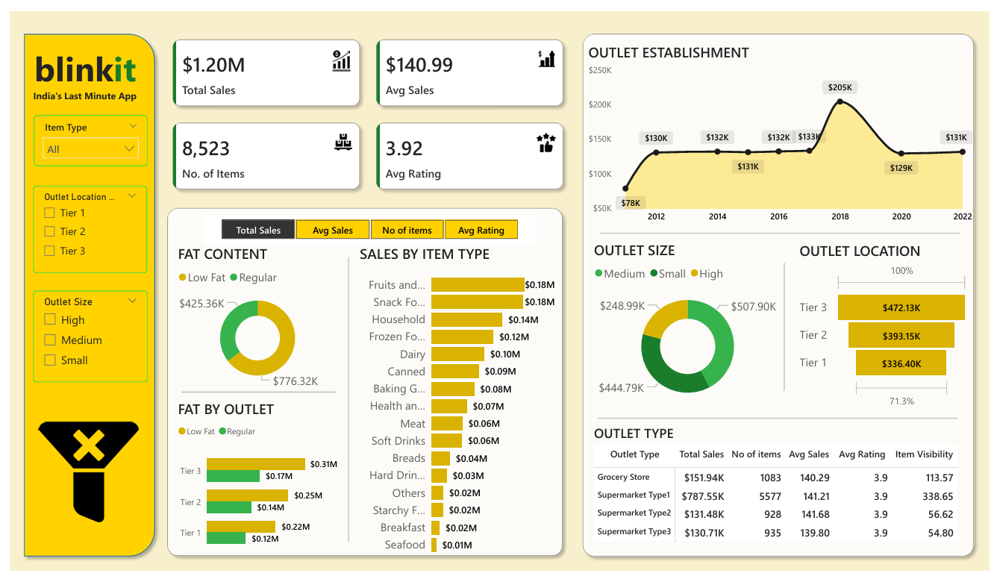
Blinkit Sales Analysis Dashboard

Slide 3

Blinkit Sales Analysis Dashboard - Key Insights
Overall Revenue Generated: $1.20
Average Revenue Per Sale: $141
Total Count of Different Items Sold: 8,523
Average Customer Rating for Items Sold: 3.92
The majority of revenue comes from Fruits & Vegetables and Snacks.
Low-fat products generate more revenue than regular ones.
Tier 3 locations outperform other location types in revenue generation.
Small and medium outlet sizes generate more revenue compared to High outlets size.

Slide 4
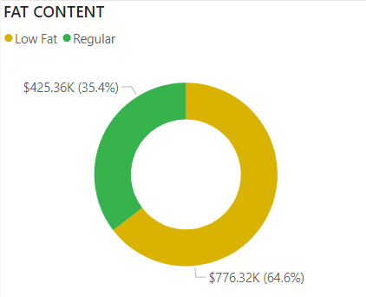
Impact of Sales on Fat Content:
“We can see from the pie chart that almost 65% of sales are attributed to Low-Fat products.”

Slide 5
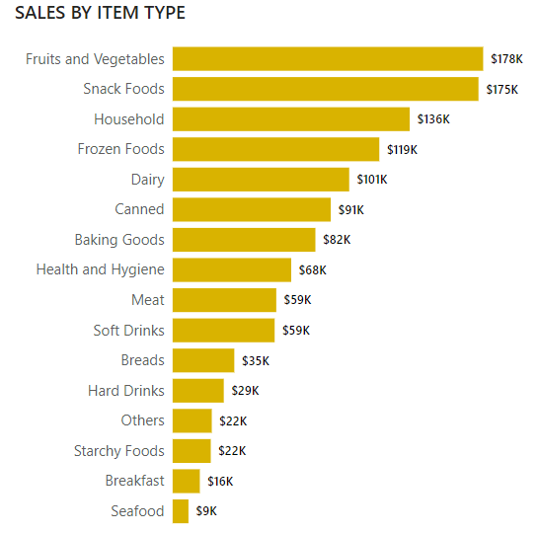
Most of the revenue is generated from Fruits & Vegetables and Snack Foods.
Very little revenue is generated from Seafood.

Slide 6
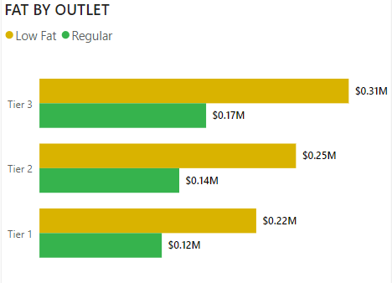
Fat Content By Outlet
From the bar chart, we can clearly see that Tier 3 outlets generate more revenue than others.

Slide 7
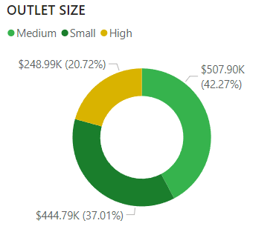
Sales By Outlet Size
We can see from the pie chart that high outlet sizes generate very little revenue compared to others.

